Slide 1


SMART INDIA HACKATHON 2026
Mausam home: actions with proof
Problem Statement Title-
Personalised homepage for the 'Mausam' mobile application
Problem Statement ID –
Theme-
PS Category- Software/Hardware
SIH26076
Smart Automation
Software
Team ID-
Team Name (Registered on portal)
Organisation
195697
Zencoderss
Ministry of Earth Sciences (IMD)
Every number shows its source, station, issue time and age. Every advisory can be re-derived by hand.
LIVE DEMO https://mausam-sih26076-devanshdhangar70-7520s-projects.vercel.app/
Guest-first PWA · works offline · English and Hindi

Slide 2
Zencoderss
THE IDEA
One home screen that adapts to you — and shows its work
The Mausam home shows a number with no context: no station, no issue time, no age — so advice is trusted or ignored at random.
WHO IT AFFECTS
Commuters in fog, farmers at sowing, parents in a heat wave — anyone reading one number and acting on it.
WHAT'S BROKEN TODAY
A one-size homepage: readings shown without source, station, issue time or age.
WHY IT MATTERS
A wrong-day sowing or a late departure costs money and safety — and the app cannot be questioned.
Proposed Solution (Describe your Idea/Solution/Prototype)
A home screen that adapts to you: map on top, action cards below.
Detailed explanation of the proposed solution
Onboarding picks your persona; the home reorders — the farmer sees sowing first, the commuter sees fog first.
How it addresses the problem
Every card says what to do and shows the readings behind it: source, station, issue time and age.
Innovation and uniqueness of the solution
Source on every number · replayable advice · honest gap cards · a grounded bot that never invents figures.

Slide 3
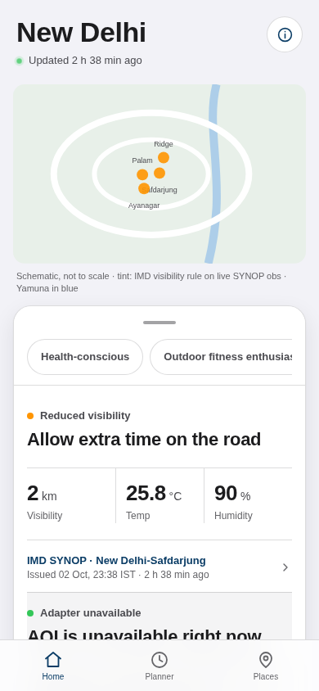
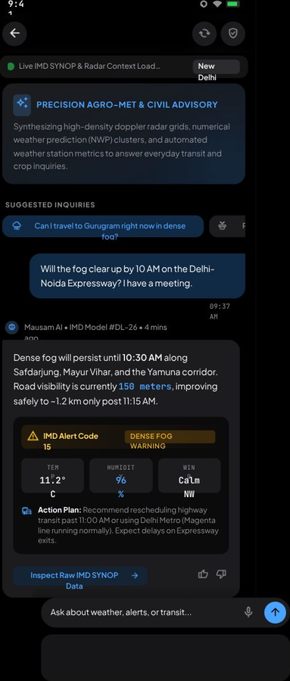
Zencoderss
TECHNICAL APPROACH
IMD data in, verified decisions out
One deterministic pipeline: IMD keyed APIs → engine → decision stack, every value carrying its source, station, issue time and age.
IMD INPUT
28 keyed APIs
WFS · CAP feed
GATEWAY
static IP host
key + hourly JWT
ENGINE
rules · replay
labelled adapters
HOMEPAGE
PWA · EN/HI
offline shell
Day-1 critical path
CLIENT
Vanilla JS PWA · Leaflet maps · service worker
SERVER
FastAPI · push · attribution ledger
DATA & APIs
IMD keyed · WFS · CAP · CPCB · CAMS
METHODOLOGY
Mock today
real captures
32 tests green
Live pipeline
keyed APIs
static IP + JWT
Finale
3 personas · push
labelled adapters
WORKING PROTOTYPE
ASSISTANT · DESIGN
The mock runs offline on captured IMD payloads; the keyed gateway is the Day-1 critical path.
Technologies to be used (e.g. programming languages, frameworks, hardware)
Methodology and process for implementation (Flow Charts/Images/ working prototype)

Slide 4
Zencoderss
FEASIBILITY AND VIABILITY
Every risk already has a working fallback
CHALLENGE
HOW WE HANDLE IT
Keyed API needs a static-IP host
Run on saved captures + public WFS meanwhile
CPCB feed may be unreachable
Labelled mirror fallback, else an honest gap card
Some IMD fields are undocumented
Documented fallbacks; the screen states its data grain
iOS limits push alerts
Demo on Android; the inbox keeps every alert
BUILD ORDER
Day 1
Week 1
Week 3
Finale
static-IP host + key registration
captured-payload mock (done)
live keyed pipeline
3 personas · push · labelled adapters
Viability: one container on a static-IP VM · one IMD API account (2 DEV + 2 PROD keys, attribution ledger on request) · no paid services · IMD data with attribution; CPCB/CAMS labelled adapters.
Analysis of the feasibility of the idea
Potential challenges and risks
Strategies for overcoming these challenges

Slide 5
Zencoderss
IMPACT AND BENEFITS
Earlier action, traceable trust
Commuter
Fog window plus “leave 20 min early”, stated as an action, not a number.
WE MEASURE
Recall of the action after the alert
Farmer
Agromet sowing window and rainfall against normal, in the order he works.
WE MEASURE
Action recalled minutes later
Health
Heat card — and “IMD does not publish pollen” where the data is missing.
WE MEASURE
Readers treating the gap as a gap
BENEFITS
■ Earlier action — each card states what to do and how fast.
■ Traceable trust — every reading names its source, station and age.
■ Works offline — the home shell keeps the last forecast.
■ Hindi + English — warning text is human-reviewed, never raw machine translation.
■ Honest gaps — missing data shows as a gap, never a fake zero.
Scalability — stateless engine, labelled adapters per source, personas as configuration: a new state needs data, not a rewrite.
Potential impact on the target audience
Benefits of the solution (social, economic, environmental, etc.)

Slide 6
Zencoderss
RESEARCH AND REFERENCES
Official sources, labelled adapters, no invented numbers
1. IMD API reference + portal user guide (key, hourly JWT, static IP)
SOURCE MAP
api.imd.gov.in
IMD official · keyed API
2. CPCB real-time AQI, GODL
data.gov.in
CPCB official · labelled adapter
3. Copernicus CAMS atmosphere data store
ads.atmosphere.copernicus.eu
Copernicus CAMS official · labelled
4. MeitY UX4G design system + PIB Mausam note (2023)
ux4g.gov.in · pib.gov.in
MeitY UX4G design standard
5. Pai, N. et al. (2014), IMD Pune gridded rainfall 0.25°
Our mock 32 tests · replay
published dataset
6. Mausam app: existing Damini lightning + Meghdoot crop modules
mausam.imd.gov.in
7. Working mock, fixtures, replay tests (32 pass)
Scan to try the live demo
https://mausam-sih26076-devanshdhangar70-7520s-projects.vercel.app/
Guest-first PWA · offline · EN/HI
Mausam/docs/evidence (illustrative)
8. Live demo – deployed PWA, guest-first, works offline
mausam-sih26076-devanshdhangar70-7520s-projects.vercel.app/
How we differ — Damini and Meghdoot show values; we show values with source, station, issue time and age, plus replayable advice and honest gap cards.
Official, verifiable sources; local mock paths are labelled (illustrative). No fabricated statistics.
Details / Links of the reference and research work

